Slide 1
Module 2
OOMD

Slide 2
CONTENT
Dynamic modeling:
Events and states – Operations – Nested state diagrams – Concurrency – Advanced dynamic modeling concepts – A sample dynamic model – Relationship of Object and Dynamic models.
Functional modeling:
Functional models – Data Flow Diagrams - Specifying operations – Constraints – A sample functional model – Relation of functional to Object and Dynamic model

Slide 3
A system can be best understood by first examining its static behavior.
Here in dynamic model , we examine the changes to the objects and their relationships over time.
Those aspects of a system that are concerned with time and changes are the dynamic model.
Control is that aspect of a system that describes the sequences of operations that occur in response to external stimuli without consideration of what the operations do , what they operate on, or how they are implemented.
The major dynamic modeling concepts are:
    events
    states
    state diagrams

Slide 4
Events:
Which represent external stimuli
States:
Which represent values of objects.
An object model describes the possible patterns of objects , attributes and links that can exist in a system.
The attribute values and links held by an object are called its state.
Over time, the objects stimulate each other, resulting in a series of changes to their states.
An individual stimulus from one object to another is an event.
The response of an event depends on the state of the object receiving it, and can include a change of state or the sending of another event to the original sender or to a third object.

Slide 5
The pattern of events, states and state transitions for a given class can be abstracted and represented as a state diagram.
A state diagram is a network of states and events.
The dynamic model consists of multiple state diagrams, one state diagram for each class with important dynamic behavior, and shows the pattern of activity for an entire system.

Slide 6
Events :
“An event is something that happens at a point in time.”
Eg:-Flight 123 departs from Chicago.
An event has no duration.
One event may logically precede or follow another, or the two events may be unrelated.
Eg:-Flight 123 must depart Chicago before it can arrive in San Francisco; the two events are casually related.
Two events that are casually unrelated are said to be concurrent, they have no effect on each other.
Concurrent events can occur in any order

Slide 7
An event is a one way transmission of information from one object to another.
An object sending an event to another object may expect a reply, but the reply is a separate event under the control of the second object, which may or may not choose to send it.
Every event is a unique occurrence but we group them into event classes and give each event class a name to indicate common structure and behavior.
E.g:-Flight 123 departs from Chicago. Flight 456 departs from Rome. Both are instances of the event class airplane flight departs.

Slide 8
Some events are signals, but most event classes have attributes indicating the information they convey.
E.g:-airplane flight departs has attributes airline, flight number and city.
The time at which each event occurs is an implicit attribute of an event.
An event conveys information from one object to another.
Some classes of events may be simply signals that something has occurred, while other classes of events convey data values.
The data values conveyed by events are its attributes, like data values held by its objects.
Attributes are shown in the parentheses after the event class name.

Slide 9
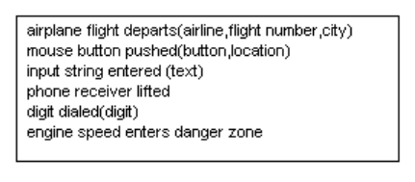
Events include error conditions as well as normal occurrences. E.g:-motor jammed, time-out

Slide 10
Scenarios and Event Traces:
A scenario is a sequence of events that occurs during one particular execution of system.
The scope of a scenario can vary.
A scenario can be thought of as a historical record of executing a system or a thought expression of executing a proposed system.
Now let us see the scenario for a telephone system

Slide 11
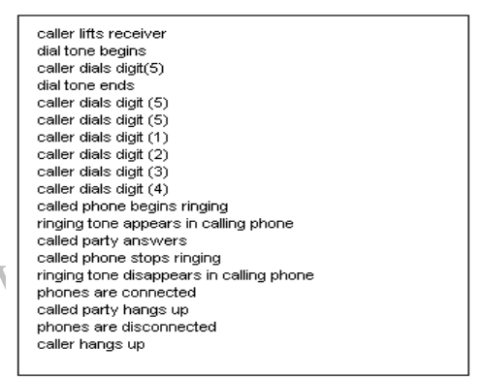

Slide 12
The next step after writing a scenario is to identify the sender and receiver objects of each event.
“The sequence of events and the objects exchanging events can both be shown in an augmented scenario called event trace diagram.”
The diagram shows each object as a vertical line and each event as a horizontal arrow from the sender object to the receiver object.
Time increases from top to bottom.
Fig()

Slide 13
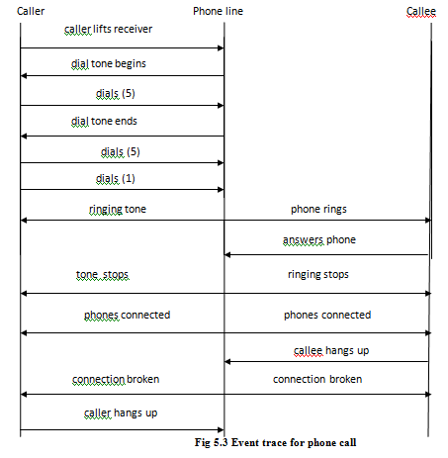

Slide 14
State:
State is the present condition
State is an abstraction of attribute values and links of an object
The set of values are grouped together into a state according to the properties that affect the behavior of object
E.g.: State of bank is solvent or insolvent depending on whether its assets exceed its liabilities
State specifies the response of object to input events

Slide 15
The response of an object to an event may include an action or change of state by the object
E.g.: After the caller lifts the receiver and before entering the first digit the phone is in the state dial tone. After the digits are dialed the phone is in the state dialing
State has duration
A state corresponds to the interval between two events received by an object
Events represent points in time and state represents interval of time
State is associated with continuous activity

Slide 16
Events and states are duals i.e. an event separates two states and a state separates 2 events.
A state is often associated with the value of an object satisfying some condition.
For example, Water is liquid when temperature of water is greater than zero degrees Celsius and below 100 degree Celsius.
A state can be characterized in various ways.
For example,

Slide 17
State Diagram:
State diagram relates events and states
Change of state caused by an event is called transition
State diagram is a graph whose node represents state and arc represents transition
State is drawn as rounded box containing an optional name
Transition is drawn as an arrow from receiving state to target state
Label on arrow is the name of event causing transition

Slide 18
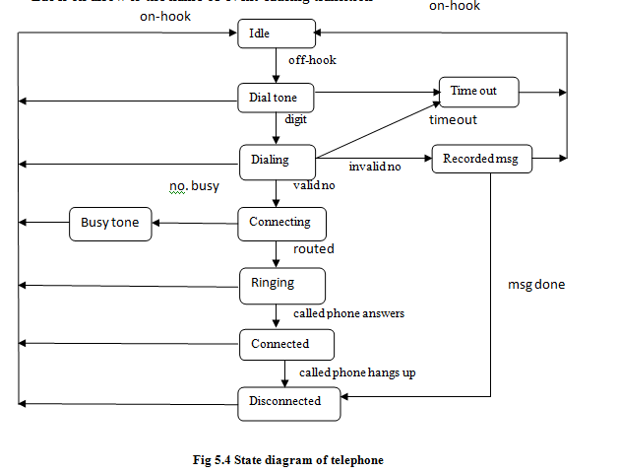

Slide 19
State diagram describes the behavior of single class of object
State diagram can represent one shot life cycle or continuous loop
One shot life cycle has initial and final state
Initial state is represented using solid circle
Final state is represented using bulls eye

Slide 20
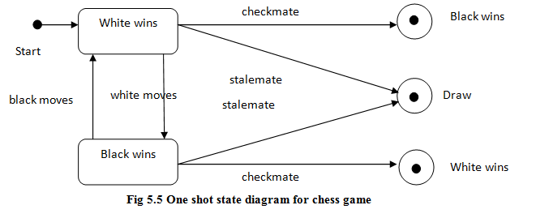

Slide 21
Conditions
Boolean function of object values
Eg: Temperature is below freezing from Nov to March
Here the condition is temperature below freezing
Has duration
Conditions can be used as guards on transitions
A guarded transition fires when its event occur only if condition is true

Slide 22
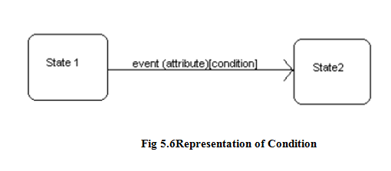

Slide 23
Operations:
State diagrams could be little use if they just described the pattern of events
A behavior description of an object must specify what the object does in response to events
Operation attached to states or transitions are performed in response to corresponding states or events
An activity is an operation that takes time to complete
An activity is associated with a state
Activities include continuous as well as sequential events

Slide 24
do: activity within the state box indicates that activity starts an entry to state and stops on exit
If an event causes a transition from the state before the activity is complete, it terminates prematurely
An action is an instantaneous operation and is associated with an event
Notation for action is ‘ / ‘

Slide 25
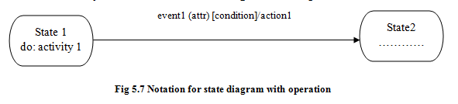
Summary of notation for state diagram with operation

Slide 26
State name is written in boldface within rounded box
Event name is written on transition arrow and may optionally followed by one or more attributes within parentheses
Condition may be listed within square brackets
An activity is indicated within a state box by the keyword “do” followed by name
An action is indicated using ‘ / ‘

Slide 27
Nested state diagram
State diagrams can be structured to permit concise description of complex systems
The way of structuring state machines are similar to the way of structuring object
Generalization allows states and events to be arranged into generalization hierarchies with inheritance of common structure and behavior
Aggregation allows a state to be broken into orthogonal components

Slide 28
Problems with flat state diagrams
State diagrams are criticized because they lack expressive power and are impractical for large problems
Consider an object with n independent Boolean attributes that affect control
Representing such object with flat state diagram require 2^{n} states
By partitioning state into n independent state machines only 2n states are required

Slide 29
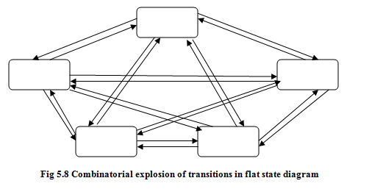
In which n² transitions are needed to connect every state to every other state.
By using proper structuring mechanism the number of transitions could be reduced as low as n.

Slide 30
Nesting state diagrams:
An activity in a state can be expanded as lower level state diagram, each state representing one step of activity
Nested activities are one shot state diagrams with input and output transitions
The set of nested state diagrams form a lattice
The lack of event label indicates that transition fires automatically when activity in state is complete.
Example

Slide 31
State generalization
Nested state diagram is a form of generalization on states
Generalization is or-relationship
An object in a state in high level diagram must be exactly one state in nested diagram
It must be in first state or second state or in one of other state
The states in nested diagram are all refinements of state in high level diagram
States may have substates that inherit the transitions of superstates

Slide 32
Fig 5.9 shows state diagram for car transmission
The transmission can be reverse, neutral or forward
If it is in forward; it can be in first, second or third gear
States first, second and third are substates of state Forward
The superstate is drawn as a large rounded box enclosing all its substates
Substates can enclose further substates
The transitions of superstate are inherited by each of its substate

Slide 33
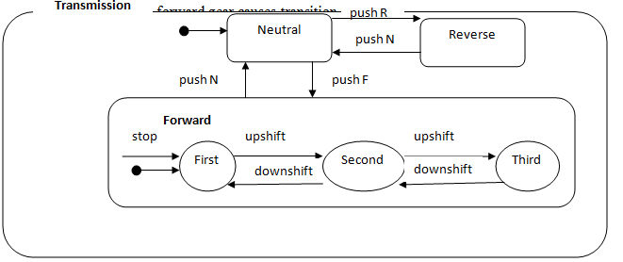

Slide 34
Event generalization
Events can be organized into generalization hierarchy with inheritance of event attributes
Fig 5.10 shows event hierarchy for keyboard events
Events mouse button down and keyboard character are two kinds of user input
Both events inherit attribute time and event and attribute device from event user input
Mouse button down and mouse button up inherit location from mouse button
Keyboard characters can be divided into control characters and graphic characters
Providing an event hierarchy permits different levels of abstraction to be used at different places in model

Slide 35
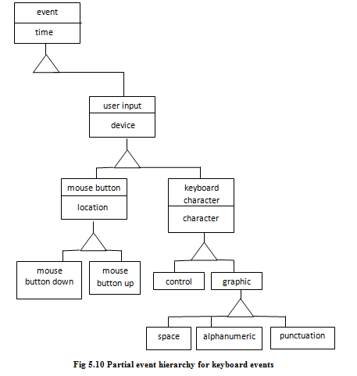

Slide 36
Concurrency:
Aggregation concurrency
A dynamic model describes a set of concurrent objects each with its own state and state diagram
Objects in the system are inherently concurrent and can change state independently
State of entire system cannot be represented by a single state in a single object
State diagram for an assembly is a collection of state diagrams, one for each component
Aggregation implies concurrency
Aggregation state corresponds to combined state of all the component diagram Car
Aggregation is the and relationship

Slide 37
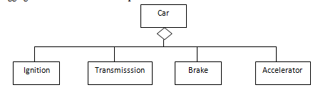

Slide 38
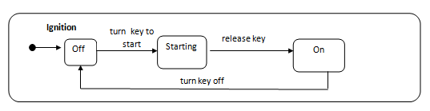

Slide 39
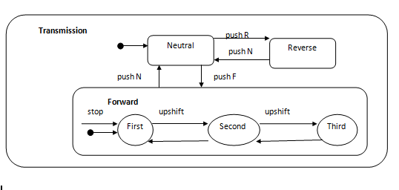

Slide 40
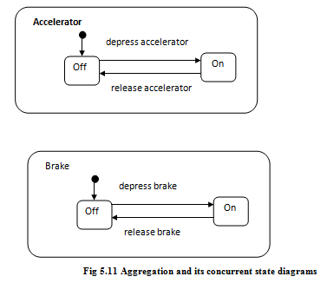

Slide 41
Concurrency within an object
Concurrency within the state of single object arises when object can be partitioned into subset of attributes, each of which has its own subdiagram
Subdiagram need not be independent, the same event can cause transition in more than one subdiagram
The name of overall composite state can be written in a separate region of box, represented by solid line from the concurrent subdiagram

Slide 42
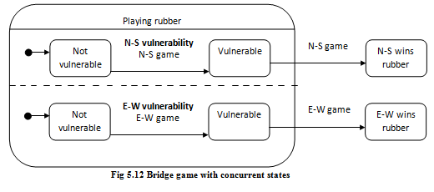

Slide 43
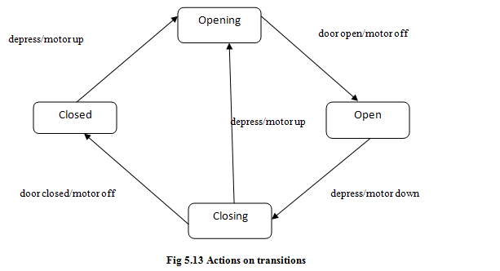
Advanced dynamic modeling concepts
Entry and Exit action
Actions can be associated with entering or exiting a state
Fig Shows the control of a garage door opener
The user generates depress events with a push button to open and close the door
The control are motor up and motor down
The events are door open and door close
Entry and exit action are useful in nested state diagram

Slide 44
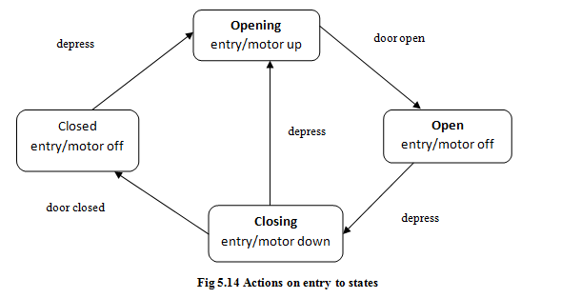

Slide 45
Whenever the state is entered , by any incoming transition, the entry action Is performed
Whenever the state is exited , by any outgoing transition, the exit action is performed first.
Exit actions are less common.
What about the order of execution of various actions and events associated with states and events?
Of all the action on the incoming transition will be executed first, then the entry action, followed by the activity within the state, followed by the exit action and finally the action on the outgoing action.

Slide 46
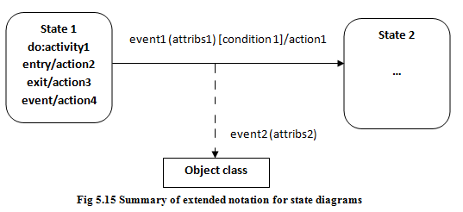
Internal action:
An event can cause an action to be performed without causing a state change .
The event name is written inside state box followed by „/‟ .
Now to differentiate between a self-transition and an internal action. Self-transition causes an entry and exit action to be executed but an internal action does not.

Slide 47
Automatic Transition
A state performs a sequential activity.
When it is over, the transition to another state fires.
An arrow without an event name indicates an automatic transition that fires when the activity associates with the source state is completed.
If there is no activity, the unlabeled transitions fires as soon as the state is entered. Such transitions are called as “lambda‟ transitions.
If a state has one or more automatic transitions but none of the guard conditions are satisfied then the state remains active until one of the conditions is satisfied or until an event causes another transition to fire.

Slide 48
Sending events
An Object can perform the action of sending an event to another object
The action “send E(attributes)” sends event E with given attributes to objects
Eg: The phone line sends a connect(ph no) event to switcher when complete phone number has been dialed
If a state can accept events from more than one object the order in which concurrent events are received may affect the final state. This is called race condition

Slide 49
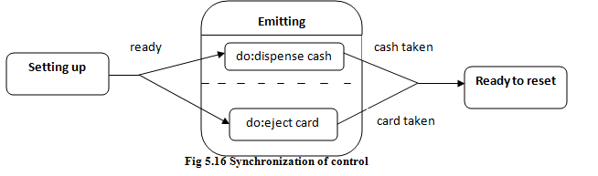
Synchronization of concurrent activities
Sometimes an object must perform two or more activities concurrently.
Both activities must be completed before the object can progress to its next state.
The target state occurs after both events happen in any order.
Eg: Consider an ATM that dispenses cash and return the users card at the end of transaction. The machine must not reset itself until the user takes both cash and card

Slide 50
Assignment test :
Sample dynamic model
Relation of object and dynamic model
Date: ………

Slide 51
Functional Modeling
Functional model describes computation within a system
Specifies what happens
Consists of multiple data flow which show the flow of values from external inputs through operations and internal data stores to external output
Specifies the result of computation without specifying how or when they are computed
Specifies the meaning of operation in object model and actions in dynamic model
Spreadsheet is a kind of functional model

Slide 52
Data flow Diagram
Data flow diagram shows functional relationship of values computed by a system including input values, output values and internal data stores
Data flow diagram is a graph whose node represent process and arc represents data flow
Data flow diagram does not contain control information
DFD contains processes that transform data, data flows that move data, actor objects that produce and consume data and data store objects that store data

Slide 53
Processes:
Process transforms data values
Process is drawn as ellipse containing description of transformation usually its name
Process has fixed number of inputs and output data arrows
The inputs and outputs can be labeled
The lowest level processes are pure functions without side effects. An entire data flow graph is a high level process.

Slide 54
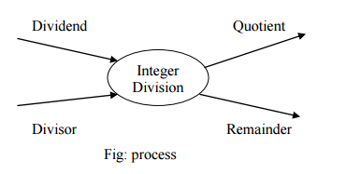

Slide 55
Data Flows :
A data flow connects the output of an object or process to the input of another object or process.
It represents an intermediate data value within a computation.
A data flow is drawn as an arrow.
Sometimes an aggregate data value is split into its components, each of which goes to a different process.
Street address
number
address
city
state
pin code
Data flow to copy a value and split an aggregate value

Slide 56
Actors:
Actors are active object that drives the data flow graph by producing or consuming values
Actors are attached to inputs and outputs of data flow graph
Actors lie on boundary of data flow graph but terminate the flow of data and are called terminators
Actors are drawn as rectangle

Slide 57
Data stores:
A data store is a passive object within a data flow diagram that stores data for later access.
A data store is drawn as a pair of parallel lines containing the name of the store.
Input arrows indicate information or operations that modify the stored data.
Output arrows indicate information retrieved from the store. Both actors and data stores are objects.

Slide 58
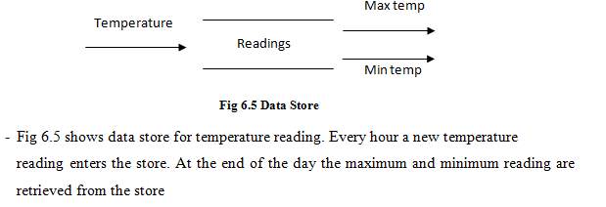

Slide 59
Nested data flow diagram
DFD is useful for showing high level functionality of a system
A process can be expanded into another DFD
Each input and output of process is an input or output of new diagram
The new diagram may have data stores
Nesting of data flow diagram permits each level to be coherent and understandable
Nesting of diagrams is also called leveling since the diagrams are organized into different levels

Slide 60
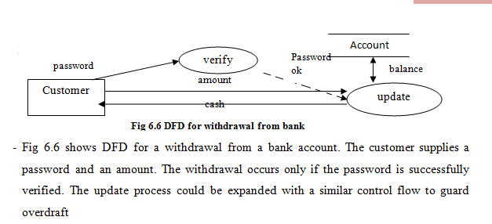
Control Flows :
A control flow is a Boolean value that affects whether a process is evaluated.
The control flow is not an input value to the process itself.
A control flow is shown by a dotted line from a process producing a Boolean value to the process being controlled.

Slide 61
Specifying Operations
Process in data flow diagram must be implemented as operation on object
Both high level and low level process are considered as operations
Each operation may be specified in various ways:
  Mathematical functions, such as trigonometric functions
  - Table of input and output values for small finite sets
  - Equations specifying output in terms of input
  - Pre- and post- conditions
  - Decision tables
  - Pseudo code
  - Natural language

Slide 62
Specification of an operation includes signature and transformation
Signature defines the interface to the operation arguments required and value it returns
Operation is listed in object model
Transformation defines the effect of operation
External specification of an operation describes changes visible outside operation
During implementation of operation internal values may be created
Internal details do not appear in external specification
Access operation are operations that read/write attributes or links of an object

Slide 63
Non trivial operations can be divided into three categories
  Queries
  Actions
  Activities
Query is an operation that has no effect on externally visible state of an object
Action is a transformation that has side effects on target object
Action has no duration
Activity is an operation which has duration

Slide 64
Constraints
Constraints show relationship between two object at same time or between different values of same object at different time
Constraints may be expressed as total function or partial function
Constraint can appear in each model
Object constraints specify that same object depend entirely or partially on another
Dynamic constraint specifies relation among states or events of different object
Functional constraint specify restrictions on operation
Constraint between values of an object over time is called invariant

Slide 65
Assignment test :
Relation of Functional to Object and Dynamic Model
Sample functional model
Date:…….

